Slide 1
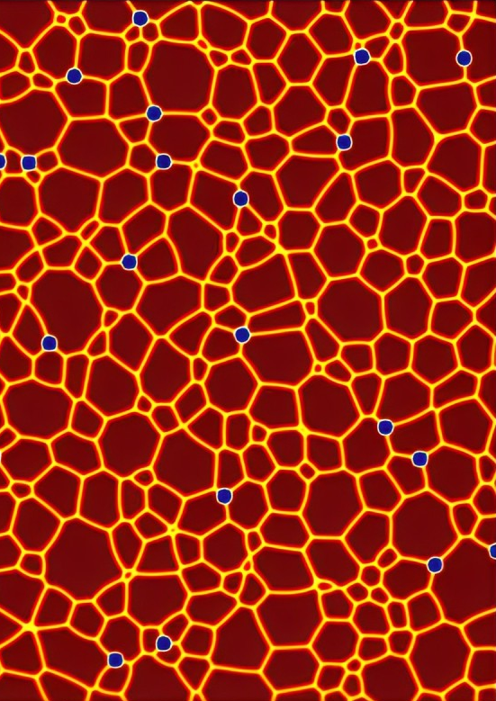

Developing a FAIR-compliant Metadata Standard for Phase Field Data using Semantic Web Resources
Austyn Nguyen
Daniel Wheeler
Phase Field Model for Grain Growth
Notes:
Better image

Slide 2

Overview
Phase Field
What is a Phase Field?
Phase Field Data
Metadata
Why Do We Need It?
FAIR Principles
RO-Crate
Case-Study with Benchmark Problem

Slide 3
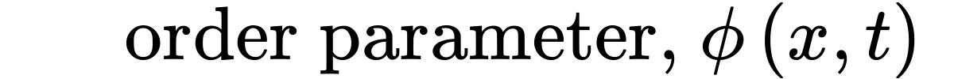
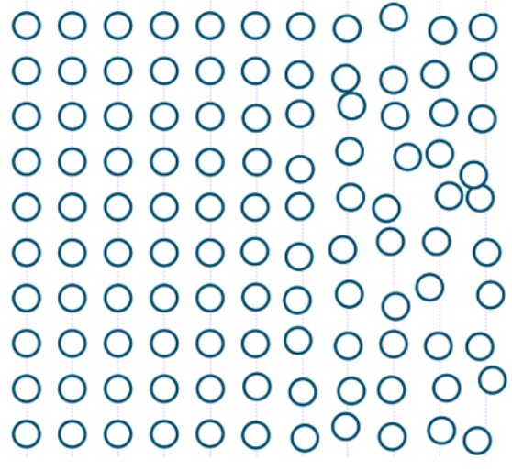
What is Phase Field?
Models evolutions of microstructure
Order Parameter:
Phase transitions with time
Order vs. Disorder
Notes:
Order vs disorder

Slide 4
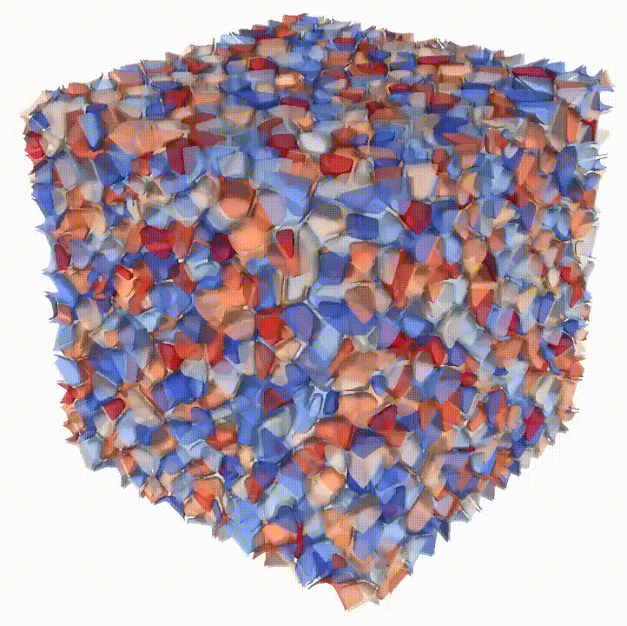
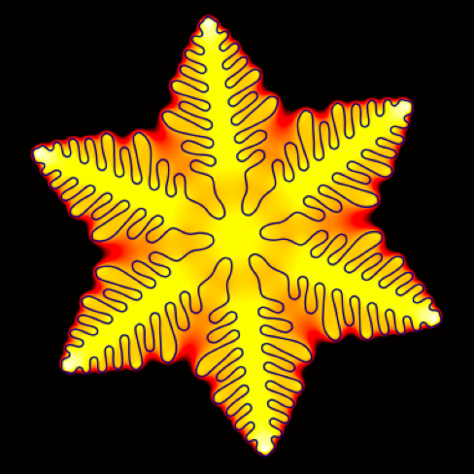
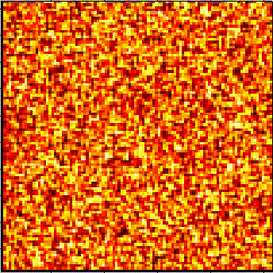
What is Phase Field?
Polycrystal
Dendrite
Phase Field Crystals
3D Grain Growth
>12 Order Parameters
2D Solidification
1 Fields, 1 Order Parameter
2D Phase Change
1 Order Parameter

Slide 5
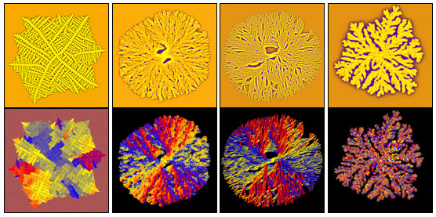
Phase Field Data
Pre-Process Data:
Evolving
Order Parameter (ɸ)
Temperature
Velocity Field
Composition/Concentration
Post-Process Data:
Total Free Energy
Volume Fractions
Interfacial Area
Average Temperature
Larger domains or more time steps→ more memory
Polycrystalline Solidification Morphologies
Phase Field
Temperature
Orientation
Concentration

Slide 6
Why Do We Need Metadata?
Simulations are costly
Reuse generated data
Extract value
Share and compare
Computational environment, problem spec., workflow, etc.
How do we include it?
FAIR Principles
Findable
Accessible
Interoperable
Reusable

Slide 7
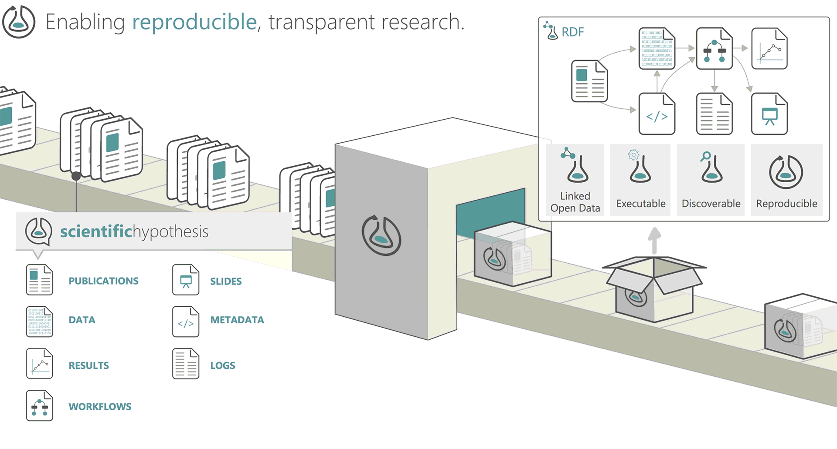
RO-Crate
1. Schema.org (2011)
Standardize schemas across web
2. BioSchemas (2016)
Package life science research data using JSON-LD
3. RO-Crate (2020)
Data packager for all research data
4. Workflow Run RO-Crate (2021)
Describes execution of computational workflow
researchobject.org

Slide 8
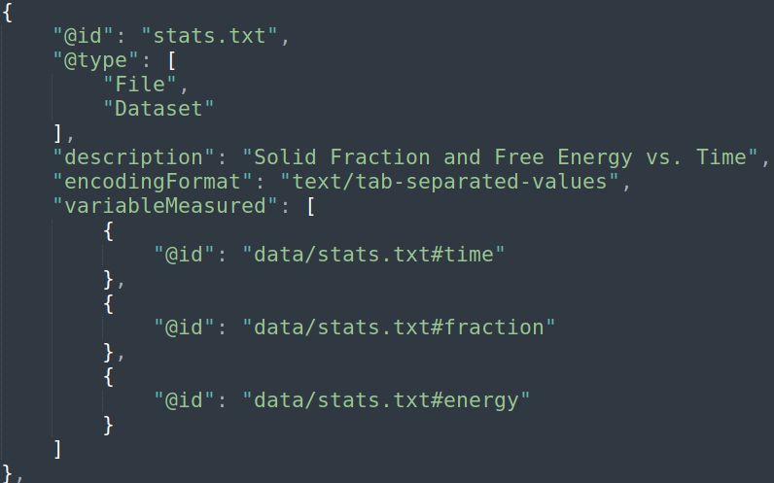
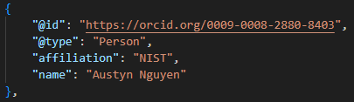
RO-Crate
Structure:
JSON-LD Format
Key: Value
Flat, Undirected Graph
Content:
Unique @id
@type defines the block
Entity: File, Person, License, Context, etc.
Workflow: Input, Output
Notes:
Add triples

Slide 9
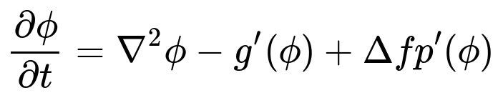
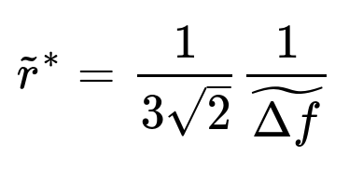
Case-Study: Nucleation
Modified Allen-Cahn Equation
Critical Radius (r*): size at which the phase is stable
r < 1r*, Shrinks
r > 1r*, Expands
Δf: Driving Force
PF is NOT a Classical Theory

Slide 10
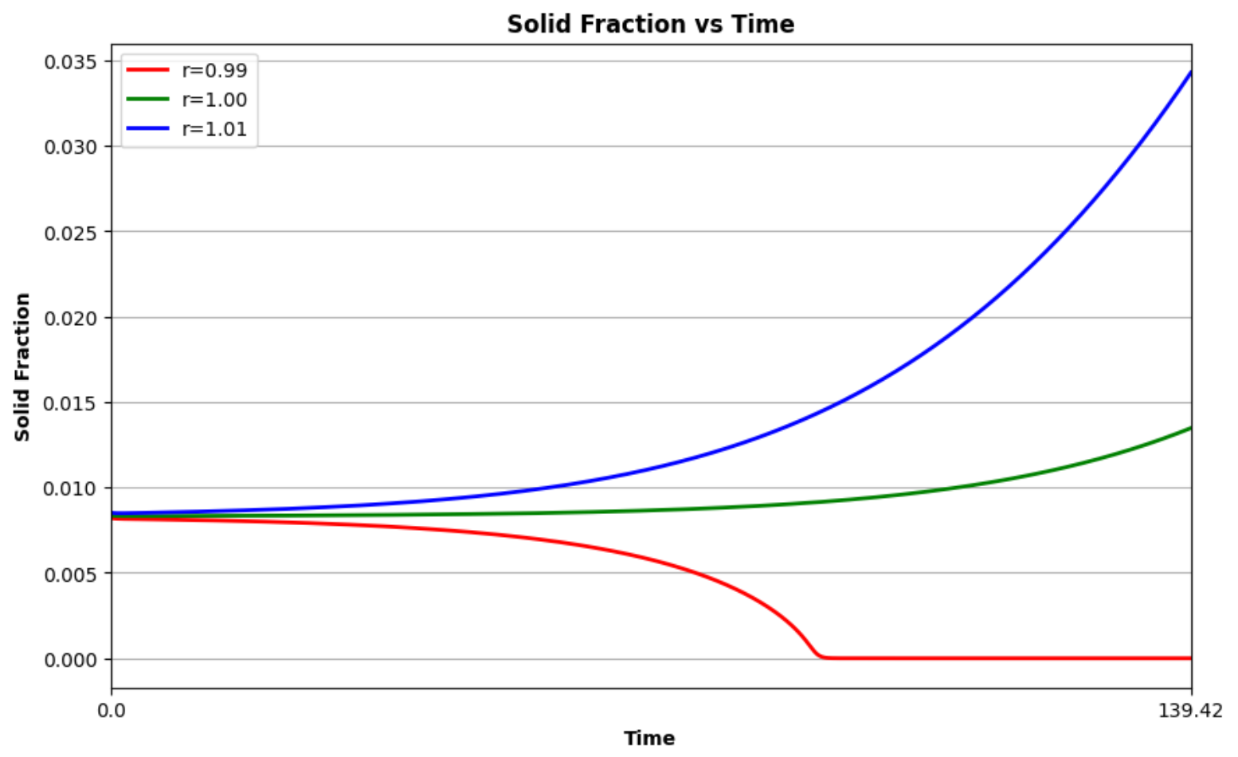
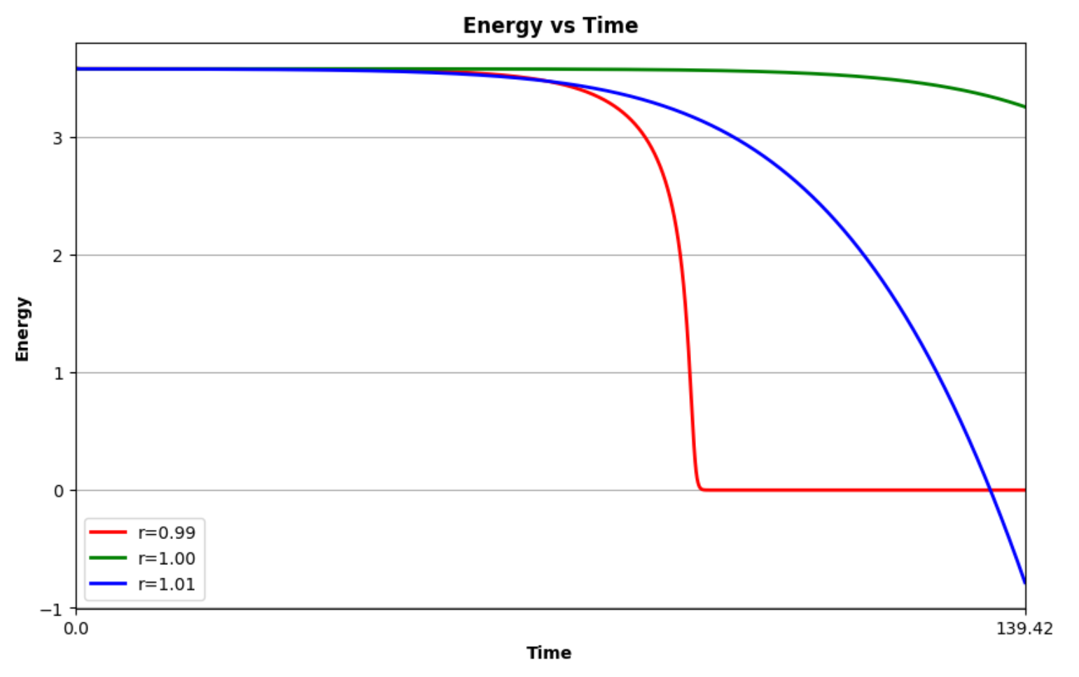

Nucleation Example
Altered initial radius (r=0.99r*, r=r*, r=1.01r*)
r=1.01r*
Notes:
Make images t= 100

Slide 11
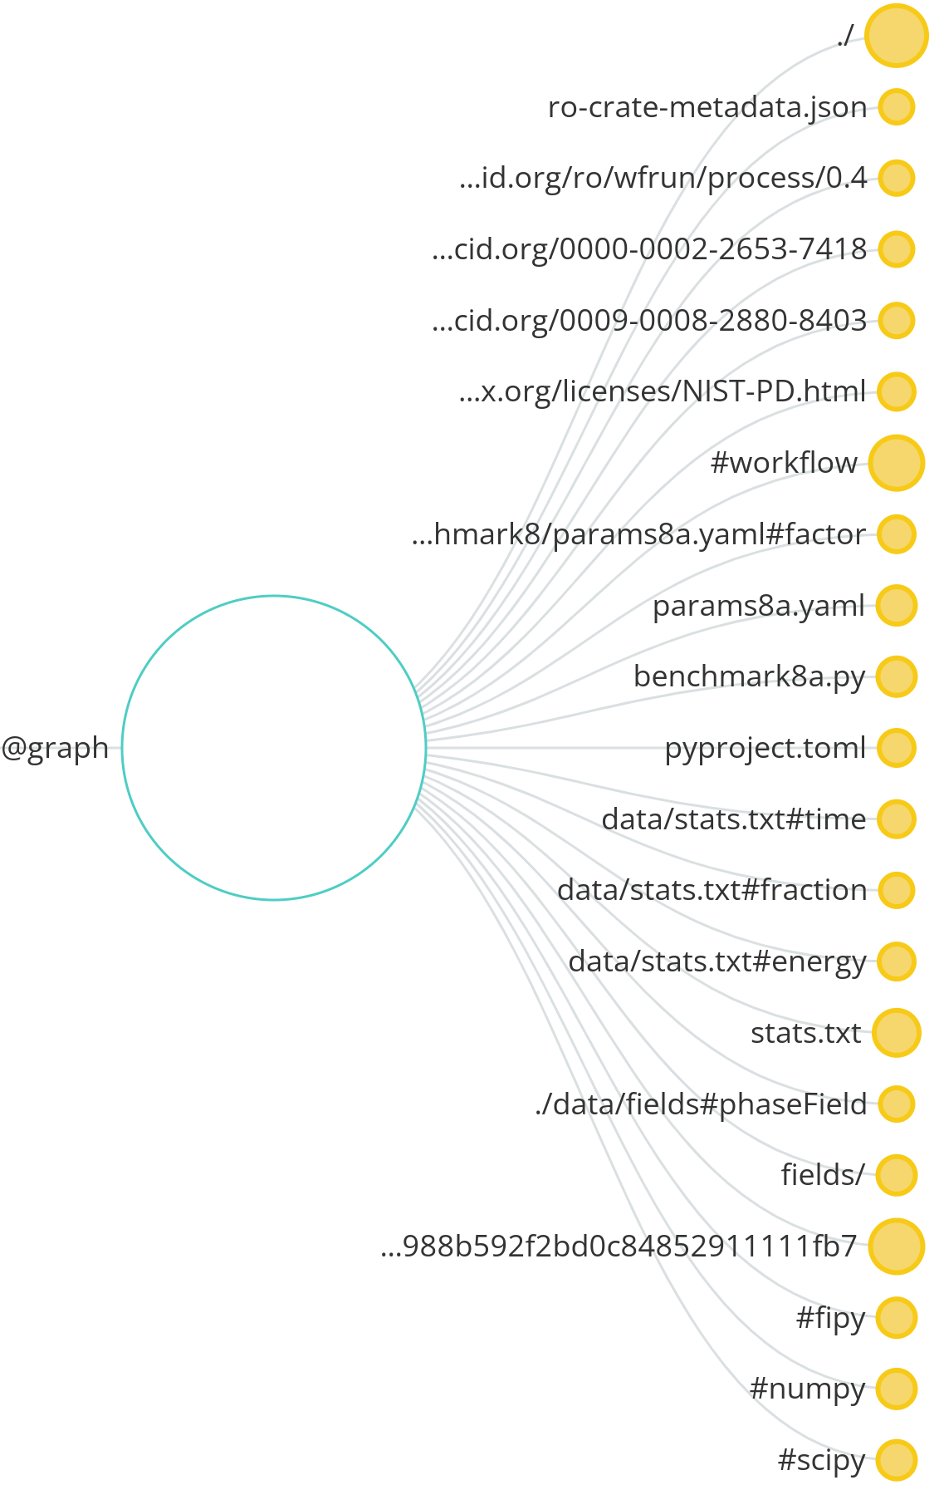
Visualized RO-Crate

Slide 12
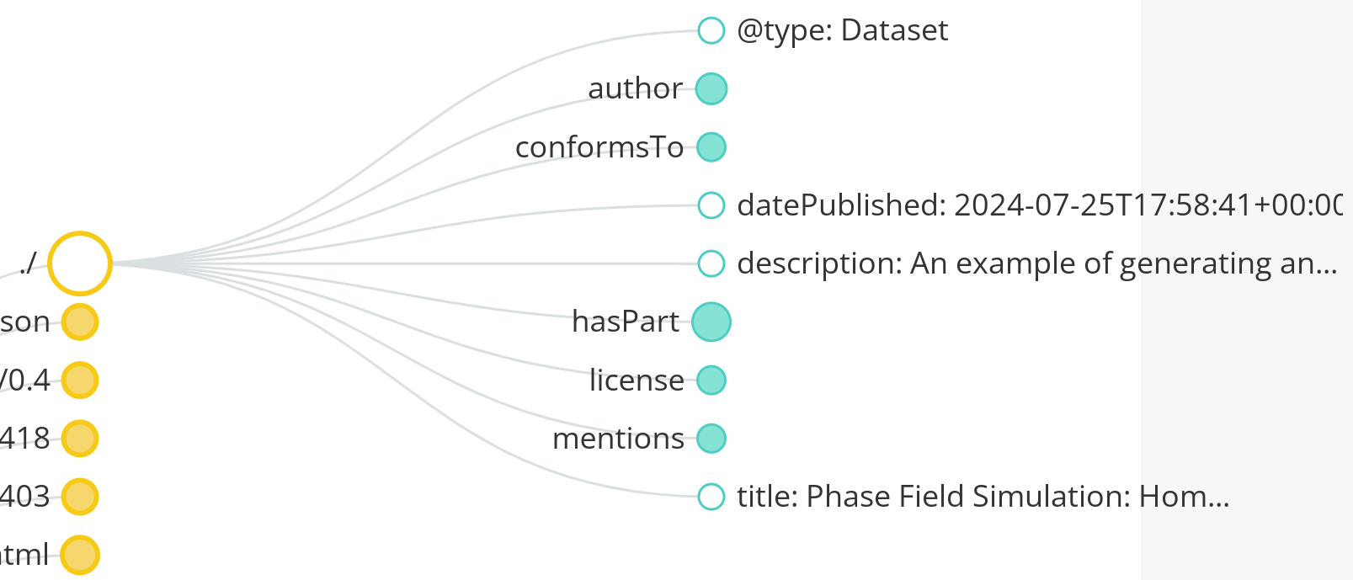
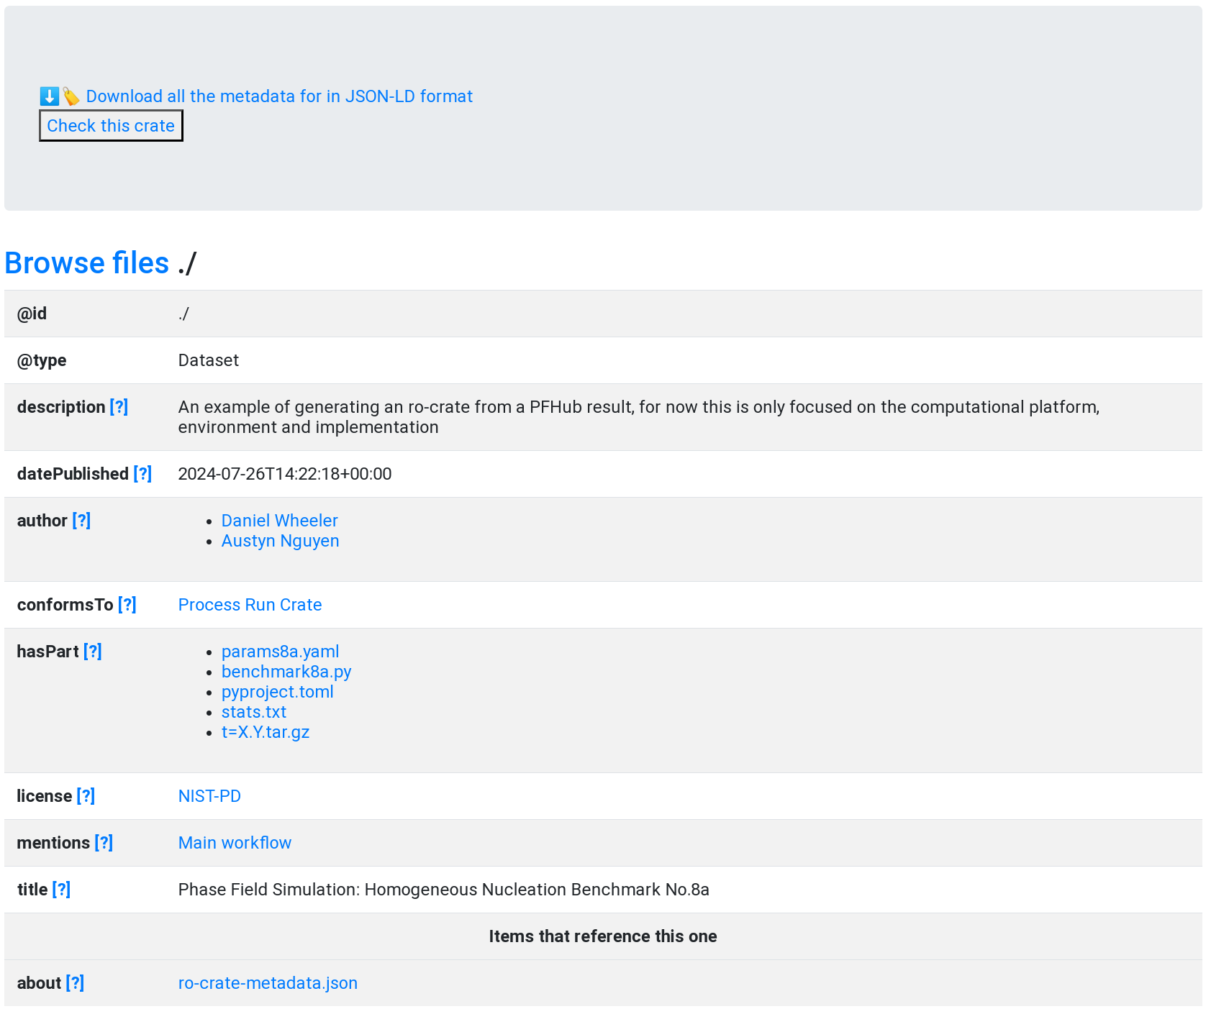
Root
Parent node
Linked to all entities
Notes:
main

Slide 13
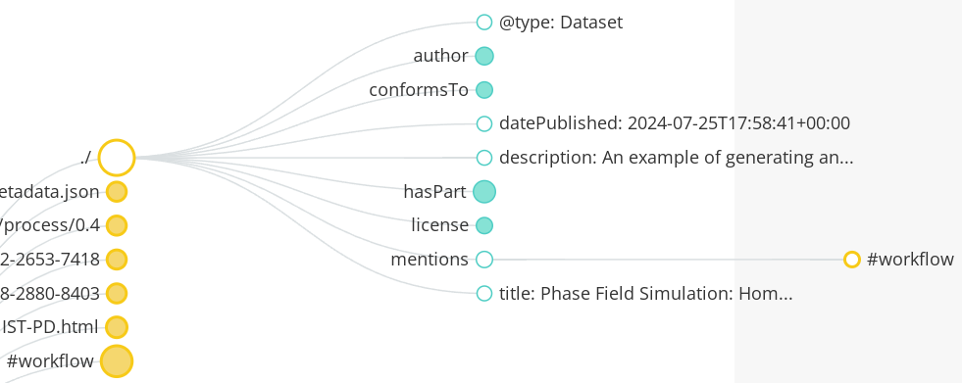
Root
Parent node
Linked to all entities
Notes:
main

Slide 14
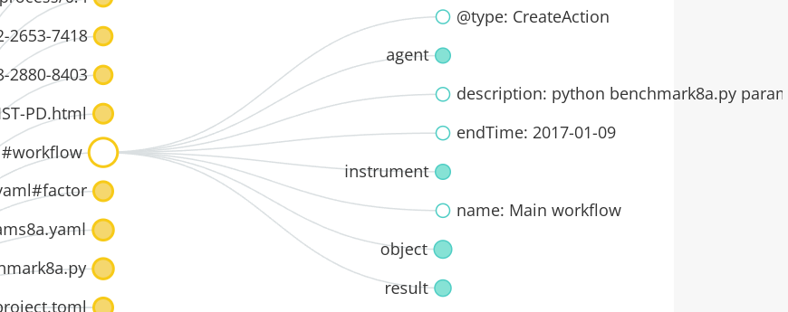
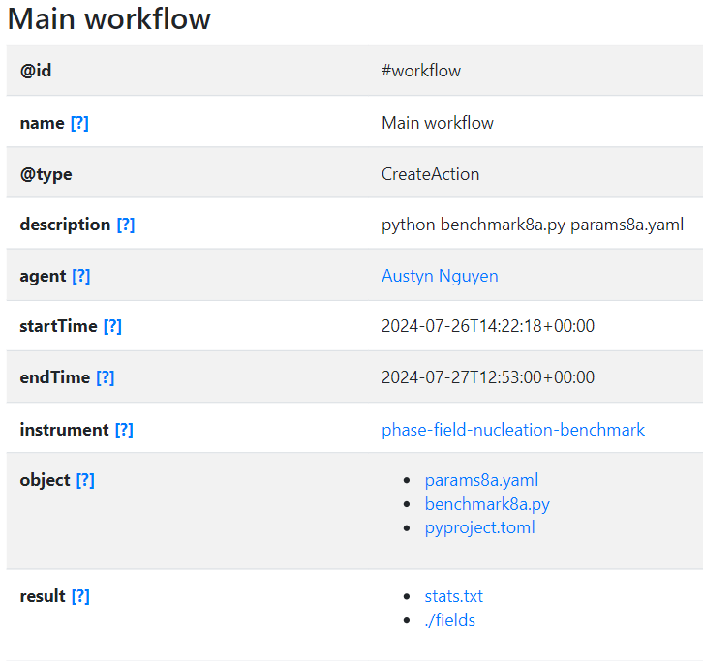
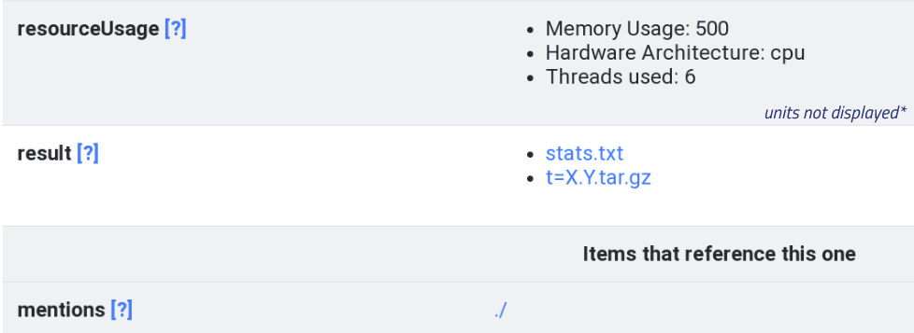
Instance
A single run of the simulation
Program execution is the description
Object (Input)
Result (Output)
Notes:
instance

Slide 15
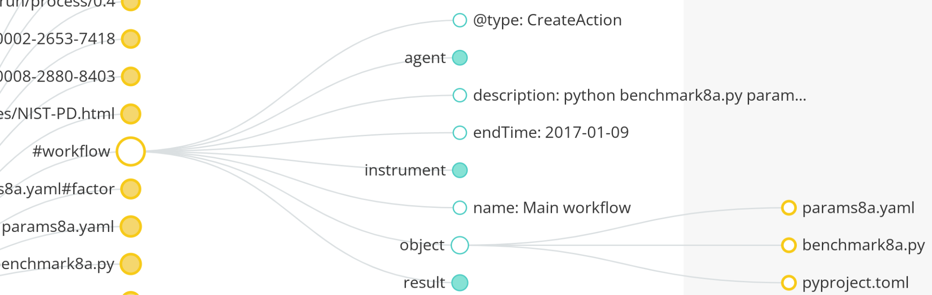
Instance
resourceUsage metadata
Program execution is the description
Object (Input)
Result (Output)
Notes:
instance

Slide 16
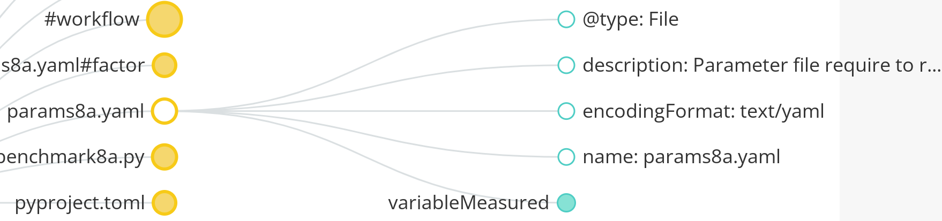
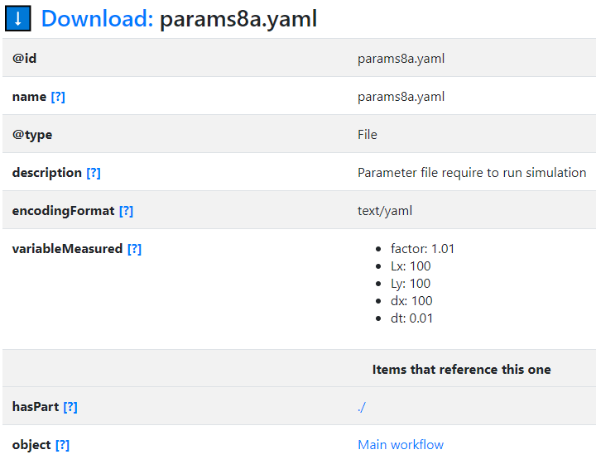
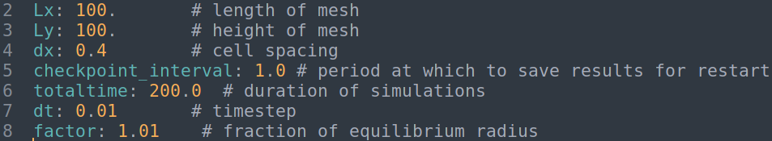
Parameters
File type
Included in workflow
7 parameters
Notes:
parameters

Slide 17
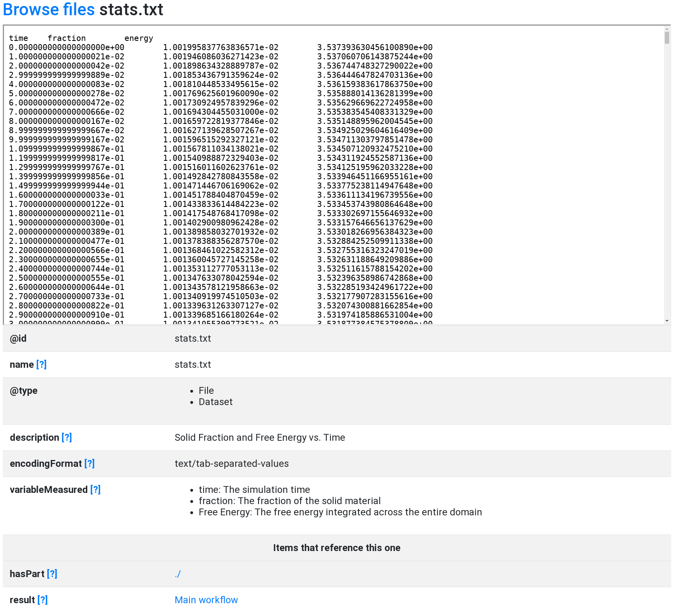
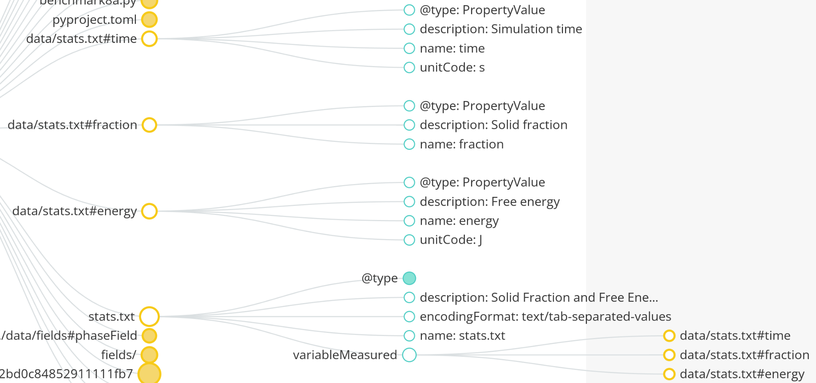
Stats.txt
(Results)
Raw file content included
Descriptive schema (variableMeasured)
Notes:
stats

Slide 18
Summary
Motivation:
Phase Field simulations are costly
Enhance shareability of existing research data
Develop a standard for research data packaging
Results:
Schema.org-based RO-Crate
Ran a Phase Field benchmark problem and outputted an RO-Crate
Issues Encountered:
Lack of schema (not everything has an existing URL)
Extracting file content to existing schema
Including problem specification
Notes:
Benefits and drawbacks of ro crate

